Slide 1
Making this resource work for you
Prior to teaching this lesson, please refer to the ‘Unit Overview and Planning Document’.
Further guidance on planning Science Mastery lessons can be found in the detailed planning guidance document.
Refer to the ‘notes’ section on each slide for useful information, including suggested expositions, pedagogical content knowledge, suggested questions, answers and more. Consider using presenter mode so you can see this guidance throughout the lesson.
The introduction slides can be adapted to suit your teaching style and the needs of your class.
Before the lesson, adapt the fix-it slide to address any misconceptions identified in the previous lesson’s exit ticket.
Choose from the suggested activities to suit your class. The intention is not that you complete all of these, but that you select those which ones are most appropriate for your students. It may be appropriate to further adapt activities for your students.
These lessons are designed to occupy approximately 1 hour. To adapt for a shorter or longer lesson duration we advise you to adapt the activity section accordingly.
Please consider using the final slide to send feedback about this lesson or examples of PowerPoints that you have adapted to our design team. Your feedback is used to improve Science Mastery for all of our teachers and students. We appreciate all suggestions and comments.
Thank you for reading!
The Science Mastery Team

Slide 2

Electrolysis in Solutions
Answer the questions below.
Which is produced at the electrode in electrolysis? ions or elements?
True or false? A metal is produced at the anode.
(HT only) Write a half equation for the production of oxygen gas at the anode.
State the ions that make up lead bromide.
(HT only) Complete the balanced half equation for the process that occurs at the cathode, in the electrolysis of molten lead bromide.
Pb²⁺ + ______ → Pb
Elements
False, the metal is produced at the cathode
2O²⁻ → O₂ + 4e⁻
Lead (Pb²⁺) and bromide (Br⁻)
2e⁻
Notes:
Big idea: Reactions Rearrange Matter
Foundation: Molten magnesium chloride is electrolysed. State what is produced at the anode and cathode.
Stretch: Explain how magnesium is formed at the negative electrode (cathode)
Answers:
Foundation: At the anode, chlorine gas is produced. At the cathode, magnesium is produced.
Stretch: Positive magnesium ions are attracted to the negative cathode. Here, they gain electrons and are discharged as magnesium metal.

Slide 3
Electrolysis in Solutions
Do Now:
Which is produced at the electrode in electrolysis? ions or elements?
True or false? A metal is produced at the anode.
(HT only) Write a half equation for the production of oxygen gas at the anode.
State the ions that make up lead bromide.
(HT only) Complete the balanced half equation for the process that occurs at the cathode, in the electrolysis of molten lead bromide.
Pb²⁺ + ______ → Pb
Drill:
Molten magnesium chloride is electrolysed. State what is produced at the anode and cathode.
Explain how magnesium is formed at the negative electrode (cathode).
Notes:
Answers:
Do Now:
1. Elements
2. False, the metal is produced at the cathode
3. 2O²⁻ + 2e- → 2O₂
4. Lead (Pb²⁺) and bromide (Br⁻)
5. 2e⁻
Drill:
At the anode, chlorine gas is produced. At the cathode, magnesium is produced.
Positive magnesium ions are attracted to the negative cathode. Here, they gain electrons and are discharged as magnesium metal.

Slide 4
Electrolysis in Solutions
Read Now:
In the late 18th century, scientists were fascinated by electricity. Ben Franklin conducted a famous experiment where he used a kite to draw electricity from lightning in 1752. Leyden jars, invented in 1746, could store charge and produce a spark of electricity. Doctors were treating patients with electric shocks for many different ailments. However, to really make progress, scientists would need to be able to produce a continuous flow of current. This was not available until 1800, when Alessandro Volta invented the electric pile, which led to the development of the first ever battery. Soon afterwards, Willian Nicholson and Anthony Carlisle used the current generated by this battery to decompose water into hydrogen and water.
What did Ben Franklin do with a kite?
What did Leyden jars do?
How did doctors use electricity in the late 18th century?
Who invented the electric pile?
What did William Nicholson and Anthony Carlisle use a battery for?
Notes:
Answers:
1. Ben Franklin used a kite to draw electricity from lightning
2. Leyden jars could store charge and produce a spark of electricity
3. Doctors used electricity to treat patients with electric shocks
4. Alessandro Volta invented the electric pile
5. Willian Nicholson and Anthony Carlisle used the current generated by a battery to decompose water into hydrogen and water.

Slide 5

C4.2.10
03/02/2025
Electrolysis in Solutions
C4.2.1 PKR: The Reactivity Series
C4.2.2 Extracting Less Reactive Metals
C4.2.3 PKR: Ions, Ionic Bonding and Deducing Ionic Formulae
C4.2.4 (HT) Ionic Equations and Displacement Reactions
C4.2.5 (HT) Writing Half Equations
C4.2.6 (HT) Ionic Equations for the Reactions of Acids and Metals
C4.2.7 Introduction to Electrolysis
C4.2.8 Extracting Metals by Electrolysis
C4.2.9 Electrolysis of Molten Ionic Compounds
C4.2.10 Electrolysis in Solutions
C4.2.11RP: Electrolysis of Aqueous Solutions 1
C4.1.12 RP: Electrolysis of Aqueous Solutions 2
C4.1.13 TIF: Corrosion and its Prevention
C4.2.14 (HT) Obtaining Raw Materials
C4.2.15 Recycling Metals
C4.2.16 Feedback Lesson
Notes:
Big Idea: Reactions Rearrange Matter
Student have explored electrolysis of molten ionic compounds and should now be confident in writing half equations to represent the discharge of ions at the electrodes. In this lesson, we will build on that learning by introducing the electrolysis of solutions with more than one type of positive or negative ion.
Suggested Hook:
Ask students what will be produced when sodium chloride in water is electrolysed. When students suggest sodium and chlorine, tell them that that is incorrect, and to think about why. Ask them what effect they think the water in the solution will have..

Slide 6

Following this lesson, students will be able to:
List the ions present in the electrolytes of molten salts and salt solutions.
Explain which ions are discharged at the anode and cathode.
Predict what will be observed at the anode and cathode.
Write half equations for the discharge of ions at each electrode.
Key Words:
discharged
hydroxide ion
anode
cathode
Notes:
Guidance:
See unit overview document and planning guidance to see how these objectives are typically assessed at GCSE, including examples of what students should be able to do following this lesson.
Planning for different needs:
The learning objectives given on this slide are suggested based on the most common requirements for exams, however they can be adapted based on the needs of different classes.
For best practice, the unit preparation booklet should be used to determine the appropriate focus of lessons within the unit.
While it is not possible to explicitly split content into levelled grades, we recommend that lesson objectives can be classified as critical, core or stretch.
Critical: the content or skill is essential for all students to be able to progress.
Core: the content or skill is important for students to progress, but other opportunities may be available to revisit it.
Stretch: the content or skill may not be essential for all students but is important for students aiming for the highest grades.
Key skill: this is a crucial skill being developed in this unit as part of the skill mapping
C4.2.10 Lesson Objectives:
Critical: List the ions present in the electrolytes of molten salts and salt solutions.
Critical: Explain which ions are discharged at the anode and cathode.
Core: Predict what will be observed at the anode and cathode.
Stretch: Write half equations for the discharge of ions at each electrode.

Slide 7
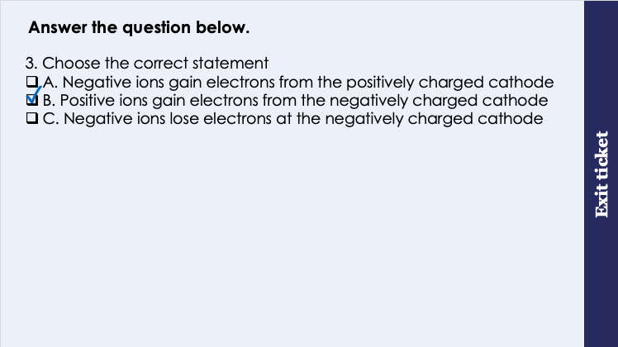
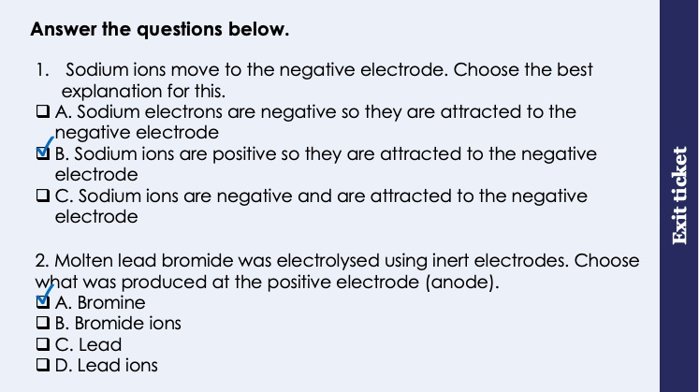
This is the fix-it portion of the lesson
The fix-it is an opportunity to respond to gaps in knowledge, especially those identified by the previous lesson’s exit ticket.
The teacher should customise this slide as needed, to facilitate
reteach, explanation, demonstration or modelling of ideas and concepts that students have not yet grasped or have misunderstood.
practise answering specific questions or of key skills.
redrafting or improving previous work.
Notes:
Fix-it guidance from previous exit ticket:
Q1. Answer: B
If students answer A, they made the mistake of thinking that sodium ions are negatively charged. To fix-it, ask students to draw the electronic configuration of a sodium atom. Discuss how these atoms lose electrons (just as other metal atoms do), and that this causes them to be positively charged.
If students answer C, they have made the mistake of thinking that a negative ion is attracted to the negative electrode. To fix-it, remind students that anions are attracted to the anode and cations are attracted to the cathode.
Q2. Answer: A
If students answer B or D, they have not grasped that ions are not produced at the electrodes. To fix-it, remind students that ions are attracted to the electrodes, but that neutral atoms are produced there.
If students answer C or C, they think that an ion with a positive charge will move to the positive electrode. To fix-it, remind students that anions are attracted to the anode and cations are attracted to the cathode.
Q3. Answer: B
If students answer A, they think that negative ions will lose electrons.
If students answer C, they think that negative ions move to the negative electrode.
To fix-it, use a diagram to annotate the process of electrolysis, showing the movement of different ions towards the electrodes, and where ions are gained or lost.

Slide 8
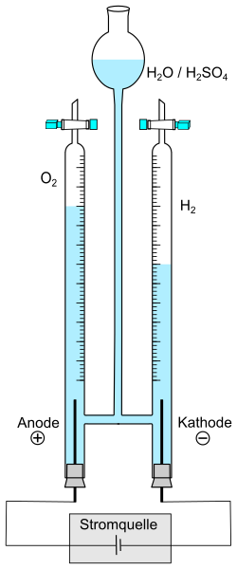
The electrolysis of water
Electrolyte
Usually water (H₂O), consisting of H⁺ and OH⁻ ions
This piece of apparatus is called the Hoffman Voltameter.
Hydrogen gas
Produced when H+ ions are discharged at the cathode
Oxygen gas
Produced when OH- ions are discharged at the anode
2H⁺ + 2e⁻ → H₂
4OH⁻ → O₂ + 2H₂O + 4e⁻
Cathode
Negatively charged
Anode
Positively charged
A cell
Generates electricity to pass through the electrolyte
Notes:
Exposition type: Demonstration
Teacher guidance:
Having this apparatus to use as a demonstration is much preferable to relying on the slide alone, if at all possible. This also has the added benefit of being able to test for the hydrogen and oxygen gases.
The half equations are required for higher tier only.
Model teacher exposition:
This piece of apparatus is called a Hoffman Voltameter. It is used to carry out electrolysis of water.
Although it looks very different to the electrolysis set up you have seen in previous lessons, it does exactly the same job, and it has all of the same parts, just arranged slightly differently.
You can see here is the electrolyte.
What is the electrolyte in this set up again? Water
You can see there is a cell connected to the anode and cathode.
What is the charge on the anode? positive
What is the charge on the cathode? negative
And why is the cell connected to the anode and cathode? So that electrical current can be passed through the water to break it up into its parts.
What do you think the ‘parts’ or the ions in water will be?
Any time electrolysis is carried out on water, or on any solution that contains water, it’s split up into the same 2 ions: H⁺ (hydrogen ions) and OH⁻ (hydroxide ions).
Dual code the formulae and names of these ions onto the board.
You can see once I turn on the apparatus, there are bubbles forming, and gas collecting.
And now you can see the benefit fo setting up our electrolysis in this apparatus: I can collect those gases using the taps at the top.
Collect a sample of each gas.
Carry out the gas tests on these to prove that you are collecting oxygen and hydrogen gases.
Notice that the volume of hydrogen gas collected is double the volume of oxygen gas. Why is this?
This is because the formula for water is H₂O – there is twice as much hydrogen!
Image source: Roland.chem, CC0, via Wikimedia Commons

Slide 9
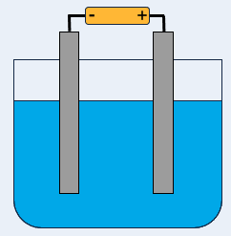
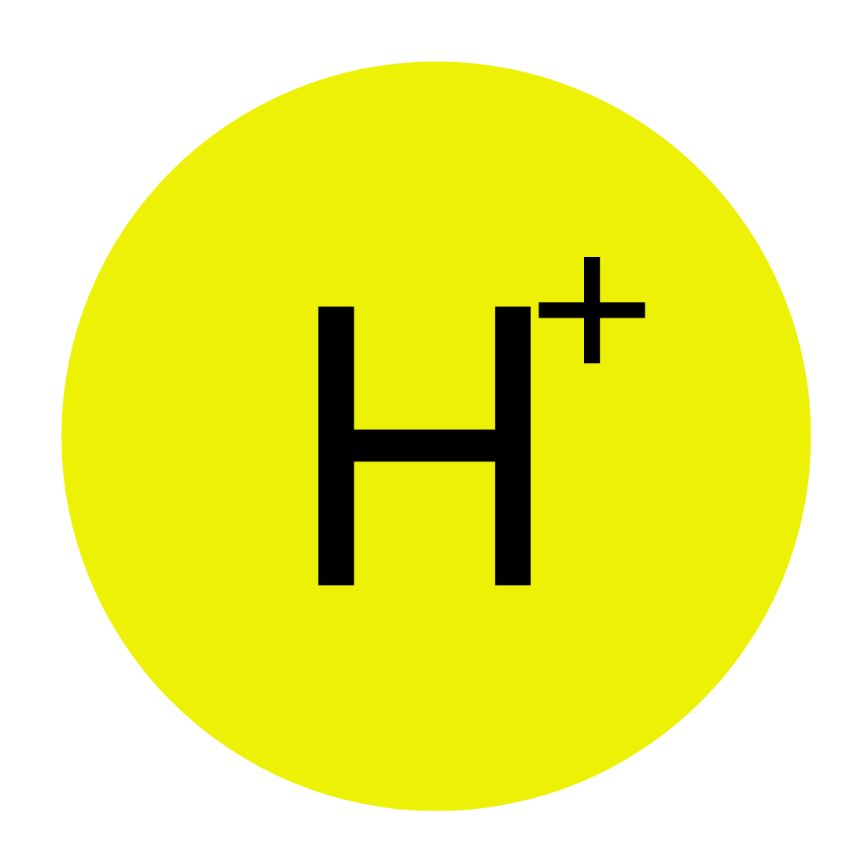
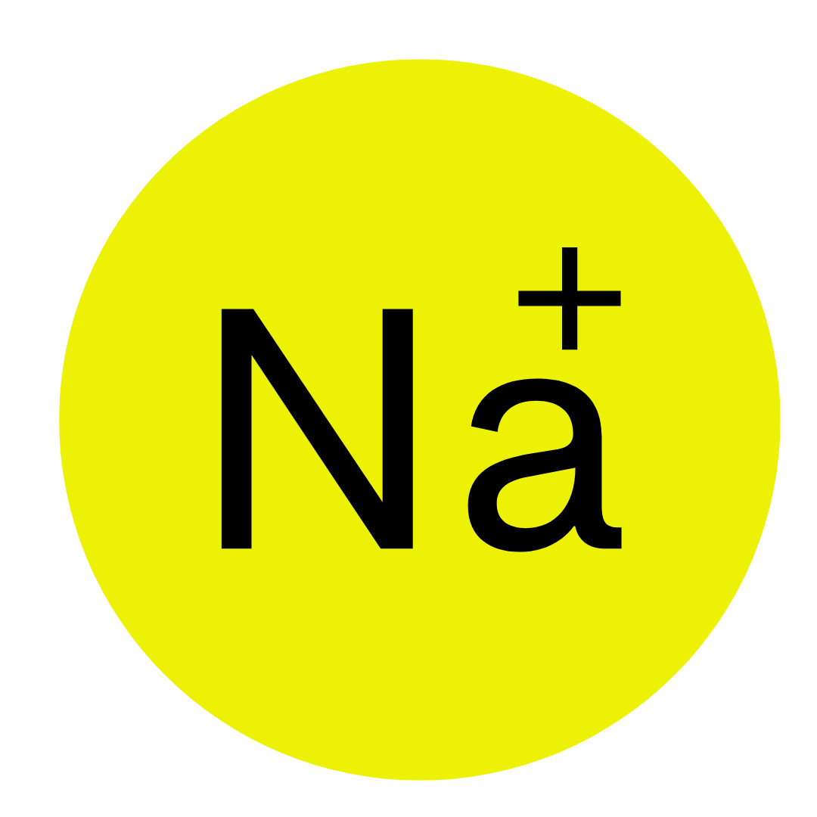
What if there are two types of positive ion in the electrolyte?
Let’s take the example of sodium chloride solution.
Sodium chloride contains the ions Na⁺ and Cl⁻.
Water contains the ions H⁺ and OH⁻.
So which positive ion is discharged at the cathode?
At the cathode, the least reactive positive ion is discharged
Therefore, in this example, H+ ions will be discharged at the cathode.
The sodium ions remain behind in the electrolyte.
Bubbles of hydrogen gas will be observed at the cathode.
Notes:
Exposition type: Demonstration
To assist your exposition, it is preferable to have a demonstration of the electrolysis of sodium chloride solution for this part of the lesson. Let students see you making up the solution with sodium chloride and water.
Model teacher exposition:
So as we have just seen water can be electrolysed into hydrogen and hydroxide ions.
In previous lessons we have seen that molten salts like sodium chloride can be electrolysed.
So, what would happen if we carry out electrolysis for a salt solution, like sodium chloride solution?
Let’s think about the positive ions first.
What is the positive ion that would result from the electrolysis of sodium chloride? Na⁺
What is the positive ion that would result from the electrolysis of water? H⁺
So, when I carry out electrolysis of sodium chloride solution, only one positive ion can be discharged at the cathode. You will need to be able to deduce which of these ions it will be.
Key point: For positive ions at the cathode, the least reactive ion is always discharged.
How will you know which is less reactive between hydrogen and sodium? Look at the reactivity series.
Direct students to look at the reactivity series handout.
You can see that hydrogen is lower down than sodium on the reactivity series, therefore hydrogen is less reactive than sodium. That means that hydrogen will be discharged at the cathode, not sodium.
The sodium will remain behind in the electrolyte, and the hydrogen will be discharged. We will observe hydrogen gas at the cathode.
Carry out the electrolysis, focusing students attention on the cathode and observing the bubbles. If possible you can even test this gas using the squeaky pop test to prove it is in fact hydrogen.
(HT only) Thinking back to your learning about half equations, let’s write a half equation for this discharge of hydrogen.
Remember hydrogen gas has the formula H₂.
Give students some time to look back at previous notes to deduce the half equation before giving the answer: 2H⁺ + 2e⁻ → H₂

Slide 10
Complete the boxes highlighted in orange.
Electrolyte name | Positive ions in the electrolyte | Negative ions in the electrolyte | Ion discharged at the cathode | Ion discharged at the anode
Molten sodium chloride
Sodium chloride solution
Na⁺
Na⁺
Cl⁻
Na⁺ + e⁻ → Na
Na⁺ H⁺
Cl⁻
OH⁻
H⁺
2H⁺ + 2e⁻ → H₂
(HT only) Can you write half equations for each ion discharged?
PANIC
Positive Anode Negative Is Cathode

Slide 11

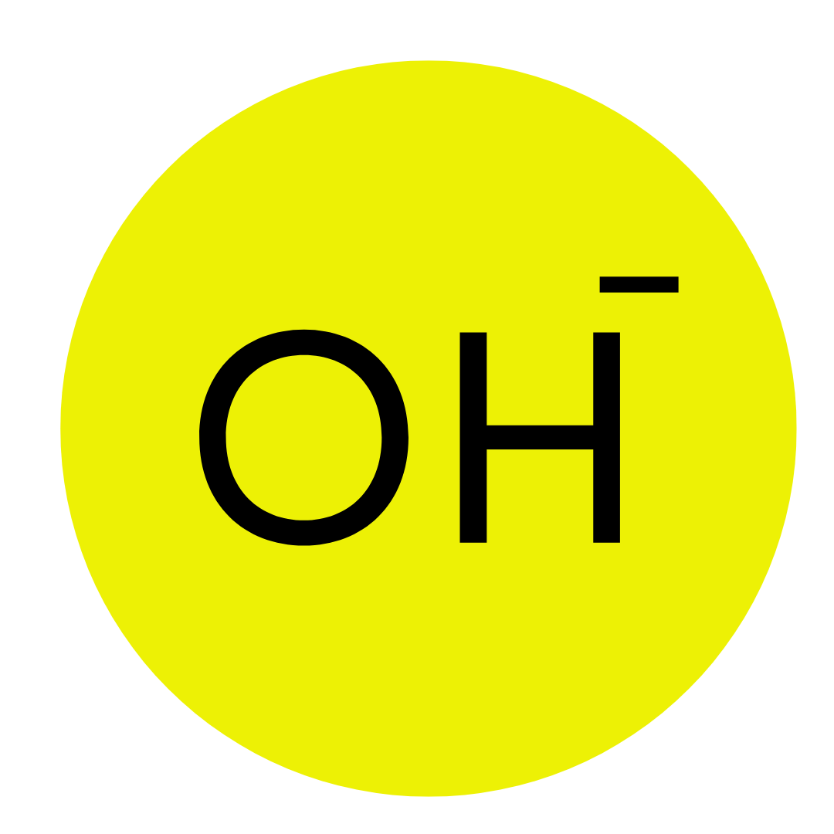
What if there are two types of negative ion in the electrolyte?
Let’s take the example of sodium chloride solution again.
Sodium chloride contains the ions Na⁺ and Cl⁻.
Water contains the ions H⁺ and OH⁻.
So which negative ion is discharged at the anode?
At the anode, hydroxide ions are usually discharged unless there is a halide ion (group 7 ion) present.
Therefore, in this example, Cl⁻ ions will be discharged at the cathode, because these are halide ions.
The hydroxide ions remain behind in the electrolyte.
Bubbles of chlorine gas will be observed at the anode.
Notes:
Exposition type: Demonstration
To assist your exposition, it is preferable to have a demonstration of the electrolysis of sodium chloride solution for this part of the lesson. Let students see you making up the solution with sodium chloride and water.
Model teacher exposition:
Now let’s think about the negative ions.
What is the negative ion that would result from the electrolysis of sodium chloride? Cl⁻
What is the negative ion that would result from the electrolysis of water? OH⁻
When I carry out electrolysis of sodium chloride solution, only one negative ion can be discharged at the anode. You will need to be able to deduce which of these ions it will be.
Key point: For negative ions at the anide, the hydroxide ion is always discharged, unless there is a halide (group 7 ion present)
You can see that there is a halide ion present, a chloride ion. That means that the chloride ion will be discharged at the anode, not the hydroxide ion.
The hydroxide ion will remain behind in the electrolyte, and chlorine will be discharged. We will observe chlorine gas at the anode.
Carry out the electrolysis, focusing students attention on the anode and observing the bubbles. If possible you can even test this gas by adding some litmus paper and watching it bleach white.
(HT only) Thinking back to your learning about half equations, let’s write a half equation for this discharge of chlorine.
Remember chlorine gas has the formula Cl₂.
Give students some time to look back at previous notes to deduce the half equation before giving the answer: 2Cl⁻ → Cl₂ + 2e⁻

Slide 12
Complete the boxes highlighted in orange.
Electrolyte name | Positive ions in the electrolyte | Negative ions in the electrolyte | Ion discharged at the cathode | Ion discharged at the anode
Molten sodium chloride
Sodium chloride solution
Na⁺
Cl⁻
Na⁺
Cl⁻
Na⁺ + e⁻ → Na
2Cl⁻ → Cl₂ + 2e⁻
Na⁺ H⁺
Cl⁻
OH⁻
H⁺
Cl⁻
2H⁺ + 2e⁻ → H₂
2Cl⁻ → Cl₂ + 2e⁻
(HT only) Can you write half equations for each ion discharged?
PANIC
Positive Anode Negative Is Cathode

Slide 13

Think outside the box!
What would be observed if you carried out electrolysis of copper sulfate (CuSO₄) solution?
Notes:
Answer:
The ions in the solution would be Cu²⁺, SO₄²⁻, H⁺ and OH⁻
Of the positive ions, copper is least reactive, and therefore the copper ions will be discharged at the cathode. Copper metal will be deposited on the electrode.
Of the negative ions, hydroxide ions will be discharged as there are no halide ions present. Therefore at the anode, bubbles of oxygen gas will be observed.
Suggested guidance:
Talk tasks can be used in a variety of ways to suit the particular needs of the students you are teaching. Through exchanging views with others, students develop their understanding of the science beyond what could be achieved individually.
Science classrooms that successfully integrate talk have the following features:
Science talk is a regular feature of lessons and is woven into classroom activities.
Students are paired or grouped strategically by the teacher to ensure productive interaction. This might take into consideration the students’ proficiency of the English language, how encouraging they might be to peers and their attainment in the topic. It’s a good idea to consider these pairings in the class seating plan.
Students are encouraged and supported to talk, but are not forced to talk.
The teacher should take on the role of a facilitator, engaging with conversations where necessary and encouraging or steering the conversation where needed.
Students are encouraged to use the language they have to express their ideas (e.g., everyday language, imperfect English, native language), but also to incorporate science specific terminology where this is more accurate or has been taught.
6. Scientifically inaccurate ideas are not dismissed by the partner or teacher; open discussion and further investigation are relied on to help students construct ideas that support them to progress in their scientific understanding.
7. Guidelines for behaviour during talk tasks are explicit and frequently reviewed. Rules for students might be:
Listen carefully to your partner
Take turns talking.
Speak one at a time, without interrupting.
Politely agree or disagree and explain why.
Politely point out if your partner has used a scientific word incorrectly, if they have explained the science incorrectly, or if there is a more accurate way to describe something.
If confused, ask questions.
Stay focused on the discussion topic.
Respond to one another.

Slide 14
Drill
What is the charge on an anode?
What is the charge on a cathode?
List the ions in molten lithium fluoride.
List the ions in lithium fluoride solution.
If the two positive ions in solution are K⁺ and H⁺, which positive ion would be discharged at the cathode?
Explain your answer to question 5.
If the two negative ions in solution are OH⁻ and SO₄²⁻, which negative ion would be discharged at the anode?
Explain your answer to question 7.
List the ions present in water.
(HT only) Write two half equations to show what happens at the electrodes in the electrolysis of molten sodium chloride.
Notes:
Purpose: This is a knowledge drill. The purpose of this is to check that the critical knowledge is secure before pupils move onto independent practice.
Suggested guidance: There are a range of ways this could be done depending on time and ability range of the class:
Mini whiteboards
As full sentences in exercise books
As short answers in exercise books
In the pupil workbook
As pair talk
As cold call

Slide 15
Drill answers
The anode is positively charged.
The cathode is negatively charged.
Molten lithium fluoride contains Li⁺ and F⁻ ions
Lithium fluoride solution contains Li⁺ , F⁻ , H⁺ and OH⁻ ions
The H⁺ ion would be discharged
Hydrogen is less reactive than potassium, therefore the hydrogen ion would be discharged
The hydroxide ion (OH⁻) would be discharged
Hydroxide ions are always discharged at the anode unless a halide ion is present. There is no halide ion present.
H⁺ and OH⁻
At the anode: 2Cl⁻ → Cl₂ + 2e⁻
At the cathode: Na⁺ + e⁻ → Na
Notes:
Purpose: This is a knowledge drill. The purpose of this is to check that the critical knowledge is secure before pupils move onto independent practice.
Suggested guidance: There are a range of ways this could be done depending on time and ability range of the class:
Mini whiteboards
As full sentences in exercise books
As short answers in exercise books
In the pupil workbook
As pair talk
As cold call

Slide 16
I: Deducing the ions discharged in electrolysis
A student carries out the electrolysis of a solution of sodium chloride.
(a) List the ions present in the electrolyte.
(b) Explain which ions will be discharged at each electrode.
(c) Describe what the student would observe when carrying out their electrolysis.
Na⁺, Cl⁻, H⁺, OH⁻
At the cathode: Of the two positive ions, hydrogen is the least reactive. This means that H⁺ ions will be discharged at the cathode.
At the anode: Hydroxide ions are usually discharged, unless a halide ion is present. In this reaction halide ions are present (Cl- ions). Therefore, the chloride ions will be discharged at the anode.
At the cathode: Bubbles of hydrogen gas would be observed.
At the anode: Bubbles of chlorine gas would be observed.
Notes:
Purpose: The I-We-You section aims to support pupils to build skills that they most commonly need when answering questions associated with this knowledge in the assessment. This section is also used to interleave other content we expect pupils to know at this stage of their education in order that they build a big picture of the science they are learning.
For the ‘I’ activity, the teacher should model how to answer the question. They can do this by narrating their thinking process aloud, and making links to learning earlier in the lesson explicit.
For the ‘we’ activity, the teacher and students work though a similar example together, in order to prepare students to be able to answer a similar question independently.
Opportunities for the ‘you’ activity – independent practise – occur in the activity portion of the lesson once the student is secure enough to process independently.

Slide 17
We: Deducing the ions discharged in electrolysis
A student carries out the electrolysis of a solution of copper (II) sulfate (CuSO₄)
(a) List the ions present in the electrolyte.
(b) Explain which ions will be discharged at each electrode.
(c) Describe what the student would observe when carrying out their electrolysis.
Cu²⁺, SO₄²⁻, H⁺, OH⁻
At the cathode: Of the two positive ions, copper is the least reactive. This means that Cu²⁺ ions will be discharged at the cathode.
At the anode: Hydroxide ions are usually discharged, unless a halide ion is present. In this reaction halide ions are not present. Therefore, the hydroxide ions will be discharged at the anode and oxygen produced.
At the cathode: Copper metal will be deposited on the electrode.
At the anode: Bubbles of oxygen gas will be observed.
Notes:
Purpose: The I-We-You section aims to support pupils to build skills that they most commonly need when answering questions associated with this knowledge in the assessment. This section is also used to interleave other content we expect pupils to know at this stage of their education in order that they build a big picture of the science they are learning.
For the ‘I’ activity, the teacher should model how to answer the question. They can do this by narrating their thinking process aloud, and making links to learning earlier in the lesson explicit.
For the ‘we’ activity, the teacher and students work though a similar example together, in order to prepare students to be able to answer a similar question independently.
Opportunities for the ‘you’ activity – independent practise – occur in the activity portion of the lesson once the student is secure enough to process independently.

Slide 18
You: Deducing the ions discharged in electrolysis
A student carries out the electrolysis of a solution of hydrochloric acid (HCl)
(a) List the ions present in the electrolyte.
(b) Explain which ions will be discharged at each electrode.
(c) Describe what the student would observe when carrying out their electrolysis.
H⁺, Cl⁻, OH⁻
At the cathode: There is only one positive ion in the solution, H⁺. This means that H⁺ ions will be discharged at the cathode.
At the anode: Hydroxide ions are usually discharged, unless a halide ion is present. In this reaction halide ions are present (Cl⁻ ions). Therefore, the chloride ions will be discharged at the anode.
At the cathode: Bubbles of hydrogen gas will be observed.
At the anode: Bubbles of chlorine gas will be observed.
Notes:
Purpose: The I-We-You section aims to support pupils to build skills that they most commonly need when answering questions associated with this knowledge in the assessment. This section is also used to interleave other content we expect pupils to know at this stage of their education in order that they build a big picture of the science they are learning.
For the ‘I’ activity, the teacher should model how to answer the question. They can do this by narrating their thinking process aloud, and making links to learning earlier in the lesson explicit.
For the ‘we’ activity, the teacher and students work though a similar example together, in order to prepare students to be able to answer a similar question independently.
Opportunities for the ‘you’ activity – independent practise – occur in the activity portion of the lesson once the student is secure enough to process independently.

Slide 19
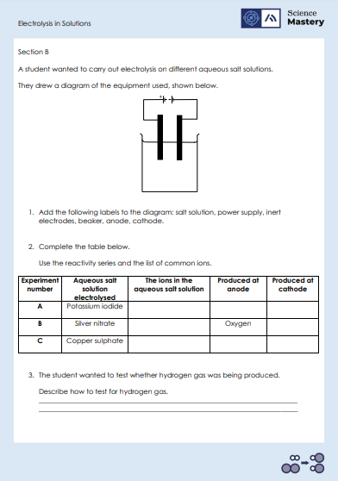
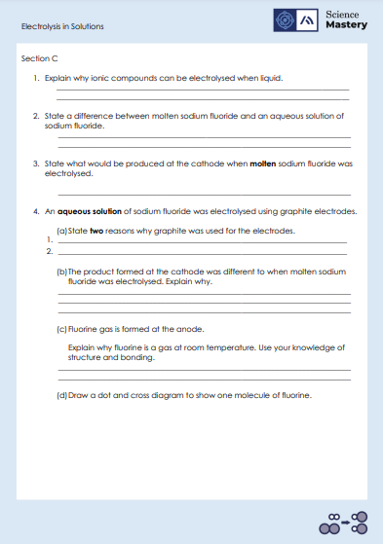
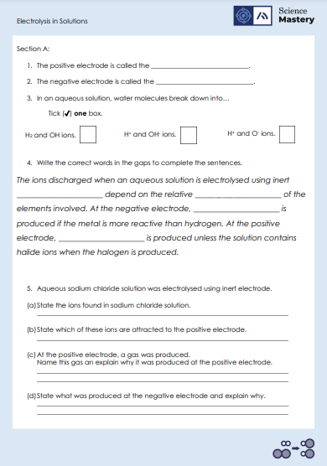
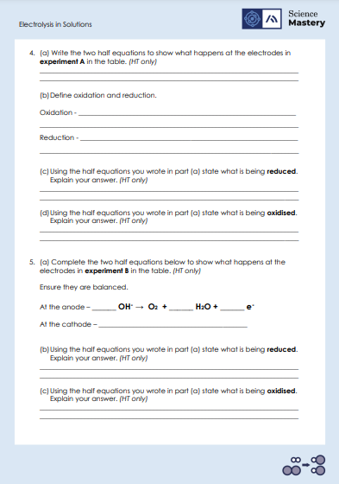
Activity

Slide 20
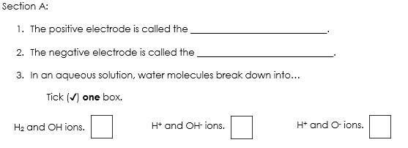
Answers – Section A
anode
cathode
✓

Slide 21
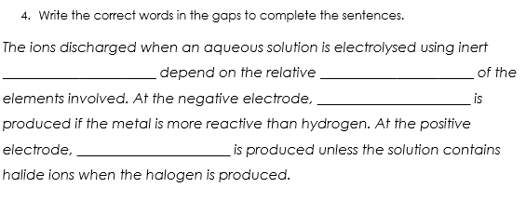
Answers – Section A
electrodes
reactivity
hydrogen gas
oxygen gas

Slide 22
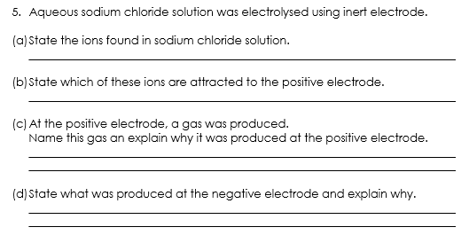
Answers – Section A
Na⁺ Cl⁻ H ⁺ OH⁻
Cl⁻ and OH⁻
Hydroxide ions are usually discharged, unless a halide ion is present. In this reaction halide ions are present (Cl⁻ ions). Therefore, the chloride ions will be discharged at the anode.
Of the two positive ions, hydrogen is the least reactive. This means that H+ ions will be discharged at the cathode and hydrogen gas produced.

Slide 23
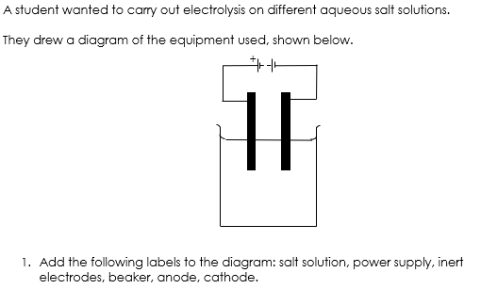
Answers – Section B
Power supply
Inert electrodes
Anode (positive electrode)
Cathode (negative electrode)
Salt solution
Beaker

Slide 24
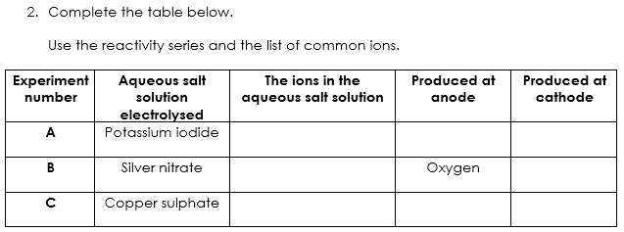
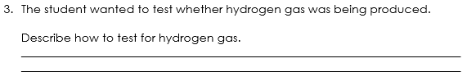
Answers – Section B
K⁺, I⁻, H ⁺, OH⁻
Iodine
Hydrogen
Ag⁺, NO₃⁻, H ⁺, OH⁻
Silver
Cu²⁺, SO₄²⁻, H ⁺, OH⁻
Oxygen
Copper
Insert a lit splint into a test tube of the gas.
If hydrogen is present then a squeaky pop sound will be heard.

Slide 25
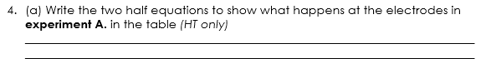
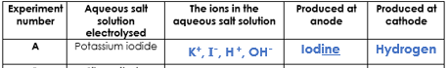
Answers – Section B
Higher Tier only
At the anode: 2I⁻ → I₂ + 2e⁻
At the cathode: 2H⁺ + 2e⁻ → H₂

Slide 26
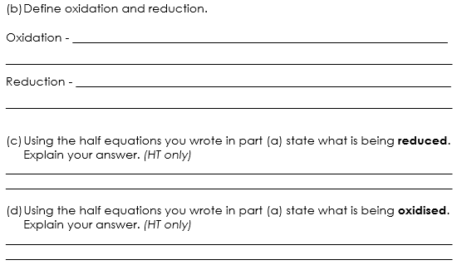
Answers – Section B
is the loss of electrons.
is the gain of electrons.
Higher Tier only
Hydrogen ions (H⁺) are reduced because they gain electrons to form elemental hydrogen (H₂).
Iodine ions (I⁻) are oxidised because they lose electrons to form elemental iodine (I₂).

Slide 27
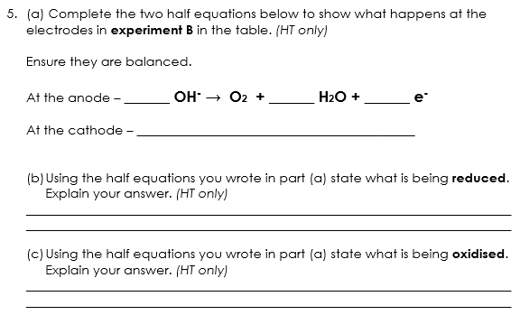
Answers – Section B
Higher Tier only
4
2
4
Ag ⁺ + e⁻ → Ag
Silver ions (Ag⁺) are reduced because they gain electrons to form elemental silver (Ag).
Hydroxide ions (OH⁻) are oxidised because they lose electrons to form elemental oxygen (O₂) and water (H₂O).

Slide 28
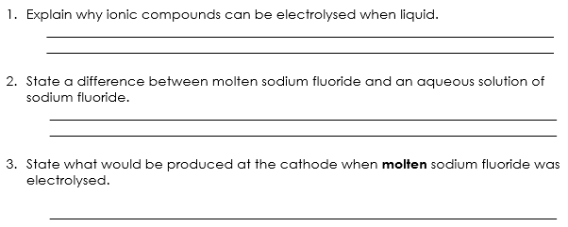
Answers – Section C
When ions are free to move in a liquid, they can conduct electricity.
Molten sodium fluoride is a pure substance whereas an aqueous solution of sodium fluoride is a mixture with water.
Sodium.
(The cathode is the negative electrode so positively charged sodium ions are discharged there)
Notes:
Answers:
Q2 – could also say that solutions have OH- and H+ ions in the mixture whereas molten salts do not.

Slide 29
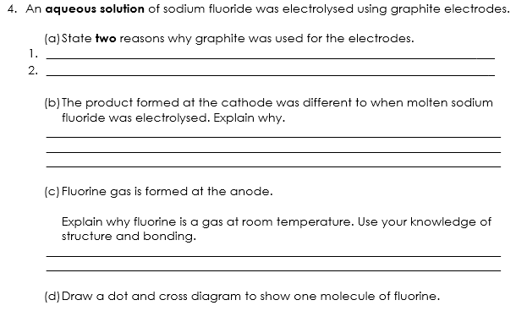
Answers – Section C
Graphite is inert so it won’t react
Graphite conducts electricity
Hydrogen gas would be produced at the cathode rather than sodium. Hydrogen is the least reactive of the two positive ions so would be discharged at the cathode.
Fluorine is a diatomic molecule with weak intermolecular forces that require little energy to overcome.

Slide 30
Answers – Section C
X
X
X
X
F
F
X
X
X
X
X
Notes:
Suggested guidance: before showing the full diagram, draw it bit by bit on the board and question students about how to draw this correctly. If there are no periodic tables available, tell students that the atomic number of fluorine is 9 before they attempt this question.

Slide 31

Compare: to outline the similarities and/or differences between things
Example question:
A scientist carries out the electrolysis of two substances;
molten sodium chloride and
sodium chloride solution.
Compare the ions discharged in these reactions.
To ‘compare’, your answer should:
Give similarities.
Write paired statements that show differences relating to the same feature.
Use the term ‘whereas’ to link your statements.
Model answer:
Both substances contain Na⁺ and Cl⁻ ions.
whereas only sodium chloride solution contains H⁺ and OH⁻ ions, from the water.
The electrolysis of molten sodium chloride causes Na⁺ ions to be discharged at the cathode, whereas the electrolysis of sodium chloride solution causes H⁺ ions to be discharged at the cathode.
The electrolysis of both substances will result in Cl⁻ ions being discharged at the anode.

Slide 32
Answer the questions below.
A student carried out electrolysis of potassium chloride solution. What was produced at the negative electrode (cathode)?
A. Potassium
B. Chlorine gas
C. Hydrogen gas
D. Oxygen gas
✓
2. In the electrolysis of copper chloride solution, which ions are in the electrolyte?
A. Cu²⁺, Cl⁻, H⁺, O²⁻
B. Cu²⁺, Cl⁻, H⁺, OH⁻
C. CuCl₂, H₂O
D. OH⁻, H
✓
Notes:
Q1. Answer: C
If students answer A, they are unable to deduce which positive ion is discharged at the cathode when there is more than one.
If students answer B or D, they do not realise that negative ions are not discharged at the cathode.
To fix-it, annotate a diagram of electrolysis with the different ions present during the electrolysis of an ionic substance in a solution of water. Narrate your thinking process to decide which ions are discharged at each electrode, and then give students different solutions to practice doing the same.
Q2. Answer: B
If students answer A, they have almost chosen the correct ions, however they have demonstrated the misconception the the ions from water are hydrogen and oxide, instead of hydrogen and hydroxide ions.
If students answer C, they have chosen the compounds that make up the electrolyte (water and copper chloride) instead of the ions that these dissociate into, as the question requests.
If students answer D, they have chosen the ions that are left behind after the other ions are used up/discharged at the electrodes. To fix-it, annotate a diagram of electrolysis with the different ions present during the electrolysis of an ionic substance in a solution of water. Show that the electrolyte is the liquid with all ions in before electrolysis occurs.

Slide 33
Answer the questions below.
3. Does water react during the electrolysis of an aqueous solution?
A. Yes, always
B. No
C. Sometimes, it depends on the solution
✓
Notes:
Q3. Answer: A
If students answer B or C, they do not realise that water always reacts when an aqueous solution is electrolysed. To fix-it, explain that although water is always split up into its ions, that is not the same as these ions are always discharged at the electrodes.

Slide 34
Lesson C4.2.10
What was good about this lesson? | What can we do to improve this lesson?
Send us your feedback by clicking this link
or by emailing sciencemastery@arkonline.org
Thank you!

